Slide 1

TITLE: Online TDS Measuring System of RO Plant
Team Details
Sl.No. | Roll No. | Div | SRN | Name
1 | 128 | F | 01FE22BEI034 | SURAJ YALAGI
2 | 120 | F | 01FE22BEI023 | VIRESH BILEBAL
3 | 132 | F | 01FE22BEI038 | MADHUSUDAN SUTHAR
4 | 125 | F | 01FE22BEI031 | PRIYANKA BALIGAR

Slide 2
TITLE: : Online TDS Measuring System of RO Plant
Content
Introduction
Objective
Motivation
Literature Survey and Gaps
Application to Real world
Methodology
Simulation
Hardware Implementation
Video documentation
Results and Observation

Slide 3
TITLE: : Online TDS Measuring System of RO Plant
Problem Statement
Design and implement Online TDS measuring system of RO plant

Slide 4
TITLE: : Online TDS Measuring System of RO Plant
Objective
Main Goal:
Develop an IoT-based TDS monitoring system that records data every hour in an Excel sheet and provides a real-time dashboard for monitoring TDS values.
Key Objectives:
Real-time TDS monitoring.
Automated cloud-based data logging.
Improved efficiency and reduced effort.

Slide 5
TITLE: : Online TDS Measuring System of RO Plant
TDS (Total Dissolved Solids) Overview:
TDS refers to the total concentration of dissolved substances in water, measured in parts per million (ppm) or milligrams per liter (mg/L).
Low TDS (< 50 ppm): May taste flat or "empty," lacks essential minerals.
Moderate TDS (50-500 ppm): Ideal range for drinking water, balancing minerals and taste.
High TDS (> 1000 ppm): Can cause water to taste bitter or salty, indicating possible contaminants.
Reverse Osmosis (RO): Removes 90-99% of TDS to produce very low TDS water.
TDS Formula (from Conductivity):
TDS (ppm) = k × EC (μS/cm), where EC is the electrical conductivity of water and k is a conversion factor (typically 0.5-1.0).

Slide 6
TITLE: : Online TDS Measuring System of RO Plant
Motivation
Current Scenario:
TDS measurement in RO plants is done manually, leading to infrequent monitoring, no real-time feedback, and the potential for human error. Data storage is also lacking, making long-term analysis difficult.
Need for Innovation:
An IoT-based system provides continuous, real-time monitoring, automated alerts, cloud-based data storage, and remote access. It reduces operational costs, enhances decision-making, and ensures water quality is always within safe limits.
Inspiration:
Inspired by advancements in IoT for smart agriculture and cities, this innovation leverages affordable sensors and microcontrollers (e.g., ESP32) to automate water quality monitoring, improving efficiency and sustainability in water treatment plants.

Slide 7
TITLE: : Online TDS Measuring System of RO Plant
Literature Survey
Existing Systems:
Manual TDS Measurement.
No Alert Mechanisms.
Limited Data Backup.
Identified Gaps:
Absence of real-time data and user-centric dashboards.
Lack of remote monitoring and control.
Our Solution:
Integrates IoT for seamless connectivity and real-time insights.
Delivers actionable data through mobile platforms.

Slide 8
TITLE: : Online TDS Measuring System of RO Plant
Applications to Real World
Water Plants
Industrial
Commercial
Sustainability Initiatives

Slide 9
TITLE: : Online TDS Measuring System of RO Plant
Methodology
Hardware Components:
TDS Sensor: Measures dissolved solids in water.
Microcontroller (ESP32): Processes sensor data and connects to the cloud.
ESP32 Features: Wi-Fi support, ADC/DAC, SPI/I2C interfaces, real-time clock.
Software Tools:
Arduino IDE: Used for programming ESP32.
Mobile/Web App: Real-time monitoring, and alerts via ThingSpeak, Blynk, Adafruit IO.
Data Backup: Logs data in Google Sheets, export data from ThingSpeak for analysis.

Slide 10
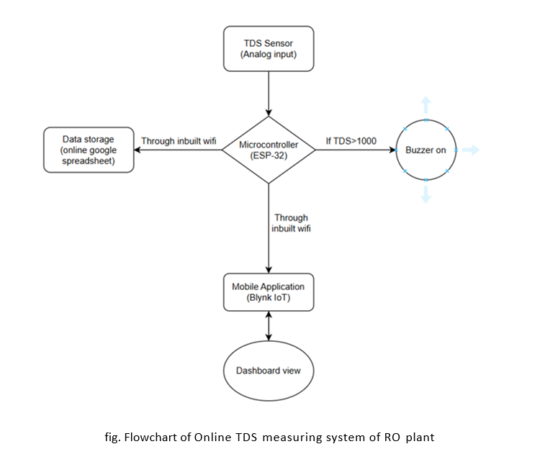
TITLE: : Online TDS Measuring System of RO Plant
Flowchart representation:

Slide 11
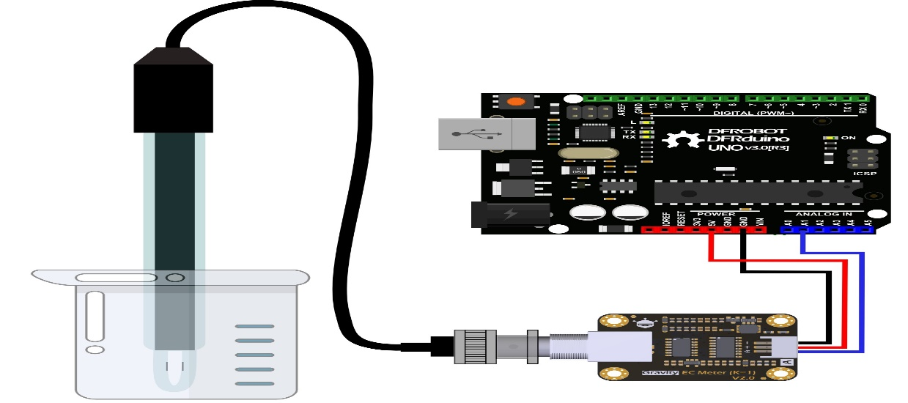
TITLE: : Online TDS Measuring System of RO Plant
Model Architecture:
References:
ESP32 to Google Spreadsheet Logging: https://www.electroniclinic.com/google-spreadsheet-or-google-sheets-with-esp8266-nodemcu-for-data-logging/

Slide 12
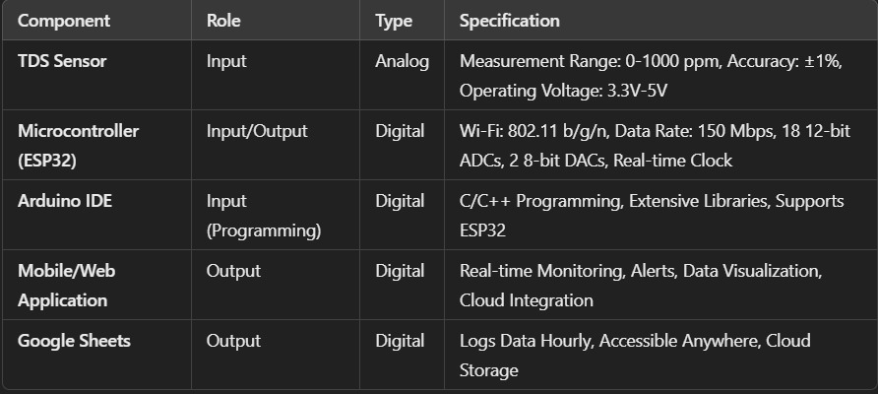
TITLE: : Online TDS Measuring System of RO Plant
Input and output
specifications :

Slide 13
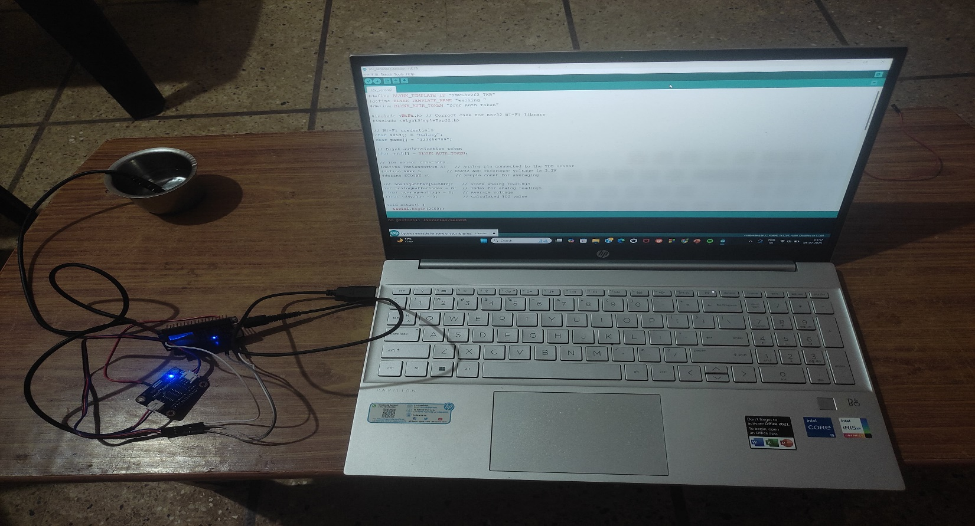
TITLE: : Online TDS Measuring System of RO Plant
Hardware Implementation

Slide 14
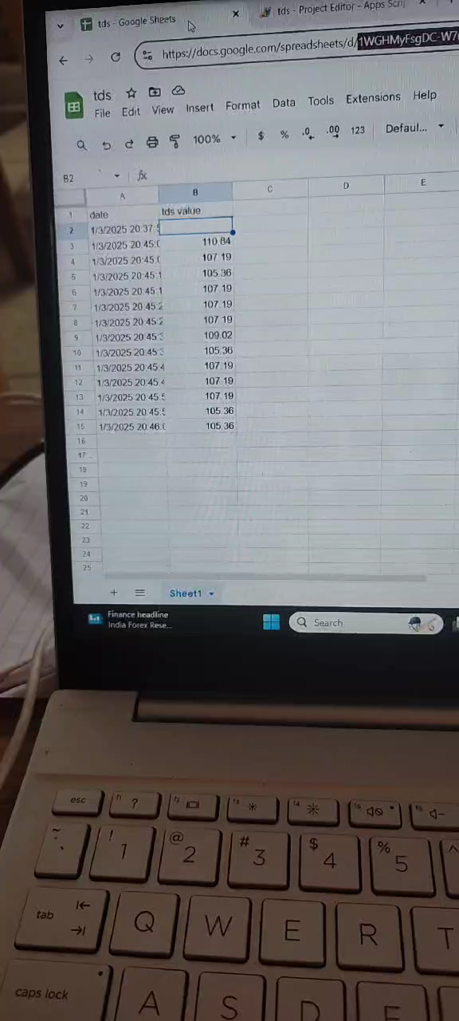
TITLE: : Online TDS Measuring System of RO Plant
Video / Image Documentation

Slide 15
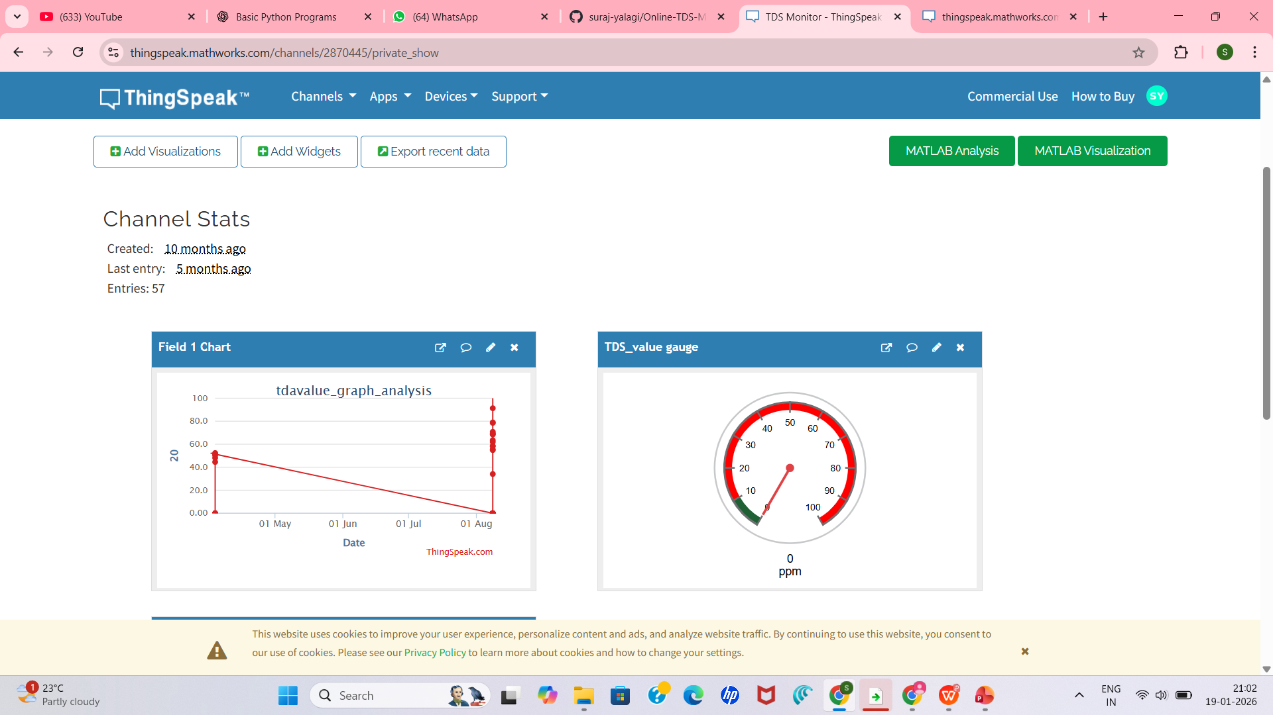
RESULT:

Slide 16
TITLE: : Online TDS Measuring System of RO Plant
Summary:
The Online TDS Measuring System for RO Plant leverages IoT technology to provide real-time water quality monitoring by measuring Total Dissolved Solids (TDS). The system automates data logging, visualizes trends via a dashboard, and sends alerts when TDS exceeds set thresholds, enhancing operational efficiency and reducing manual intervention.
Key Takeaways:
Real-Time Insights: Continuous monitoring ensures water quality compliance.
Efficiency: Improve operation reliability and reduce downtime in RO plants.
Future Prospects:
Multi-Parameter Monitoring: Expand the system to measure pH, temperature, and other water quality parameters.
Scalability: Apply the system to monitor multiple RO plants or industrial water systems.
Energy Optimization: Integrate solar power for sustainable operation in remote locations.

Slide 17
TITLE: : Online TDS Measuring System of RO Plant
Conclusion:
In conclusion, The Online TDS Measuring System for RO plants leverages IoT technology to automate and streamline the monitoring of water quality. By continuously tracking TDS levels, this system eliminates the inefficiencies of manual monitoring, providing real-time data, automated alerts, and easy data analysis. The integration of cloud-based storage ensures that data is always accessible, enabling better decision-making and predictive maintenance. This innovation enhances operational efficiency, reduces costs, and supports sustainability goals in water treatment. Ultimately, this project provides a robust solution to maintain high water quality standards, contributing to the long-term reliability and performance of RO plants.

Slide 18
TITLE: : Online TDS Measuring System of RO Plant
THANK YOU

